Slide 1


Intermediate Project Presentation
DevBallers
Atilla Dogan, Andrit Hashani, Oguzhan Kaluk, Dursun Berat Saral, Nick Waldschmidt

Slide 2
Table of Contents
Conceptual solution
Status of the project
Demo
Lessons learned
Group management

Slide 3
Conceptual solution
Establish development cycle
Issue generation
Implementation
Review
Repeat every week

Slide 4
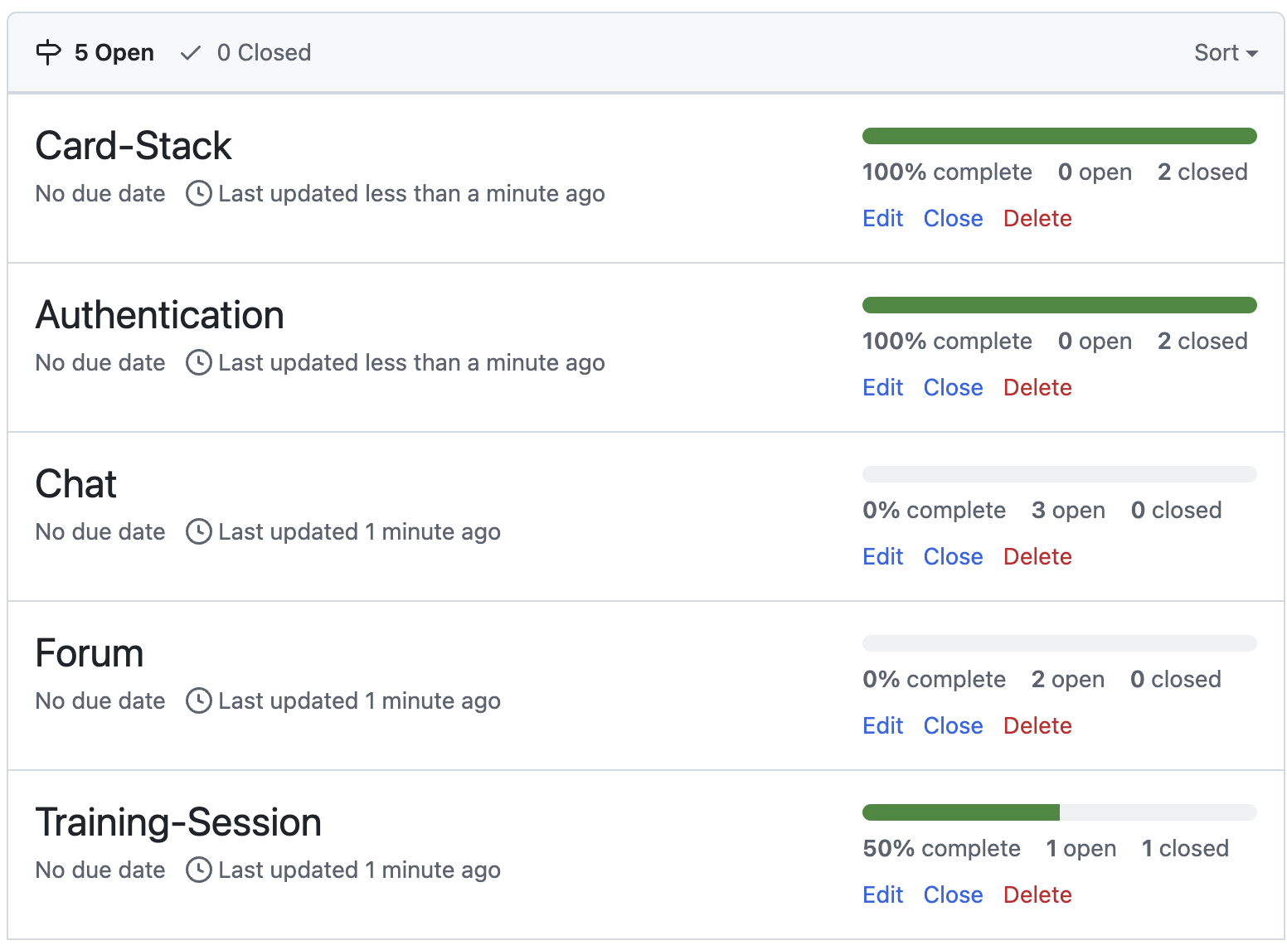
Status of the project
Finished:
Card-Stack
Authentication
In Progress:
Training-Session
To-dos:
Forum
Chat

Slide 5
Demo

Slide 6
Lessons learned
Requirements too unspecific

Slide 7
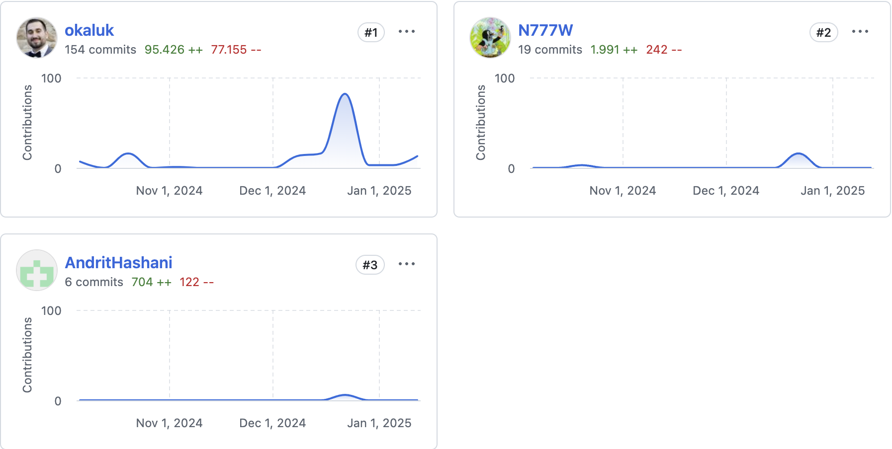
Group management
Every issue is a branch
Pull requests required
Pull request require review
Pull request require prettier enforcement
Group contributors

